Slide 1


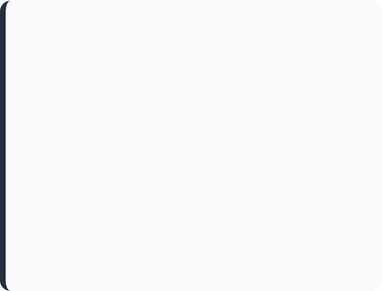

SE 2226 SOFTWARE QUALITY ASSURANCE AND TESTING PROJECT
Department: Software Engineering
Lecturer: Doç. Dr. Korhan Karabulut
Prepared By: Batuhan Türk 24070006083 Utku Celal Turgut 24070006070 Aydın Alp Boyacı 24070006059
https://www.theforage.com/blog/skills/quality-assurance

Slide 2
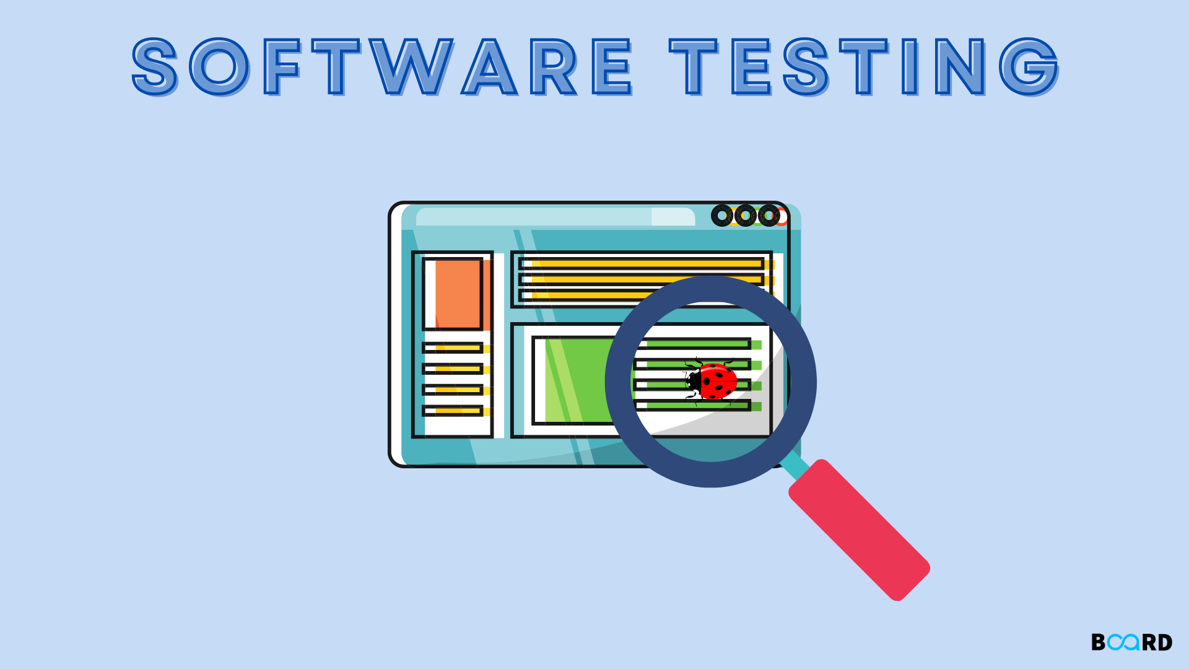
OUTLINE
1) Brief Introduction
2) BlackBox Techniques
Equivalence Class Partitioning
Boundary Value Analysis
Use Case Testing
Decision Table
3) WhiteBox Techniques
Unit Tests
https://www.boardinfinity.com/blog/software-testing-what-it-is/
Automated Testing
Mutation & Coverage Testing

Slide 3
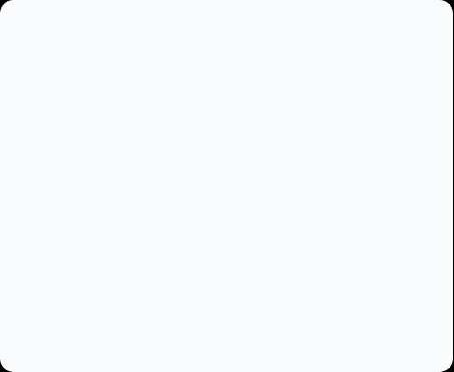

System Under Test
System Under Test:
— Amazon.com.tr
Tested Functionalities:
Search Bar
Shopping Cart
https://www.amazon.com.tr/
Payment System

Slide 4
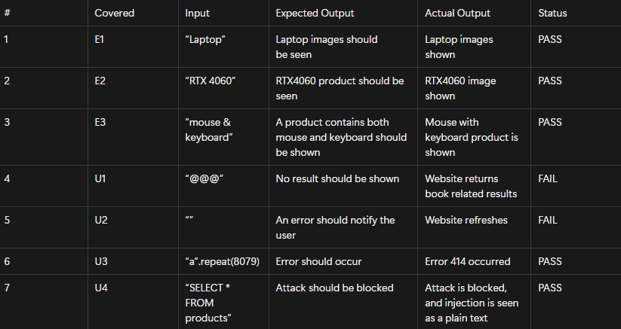
Search Bar: ECP
Tested by using:
Valid, Empty, Long String
Alphanumeric
String with Logical Exp.
Special Characters
SQL Statement
5 OUT OF 7 TESTS PASSED

Slide 5
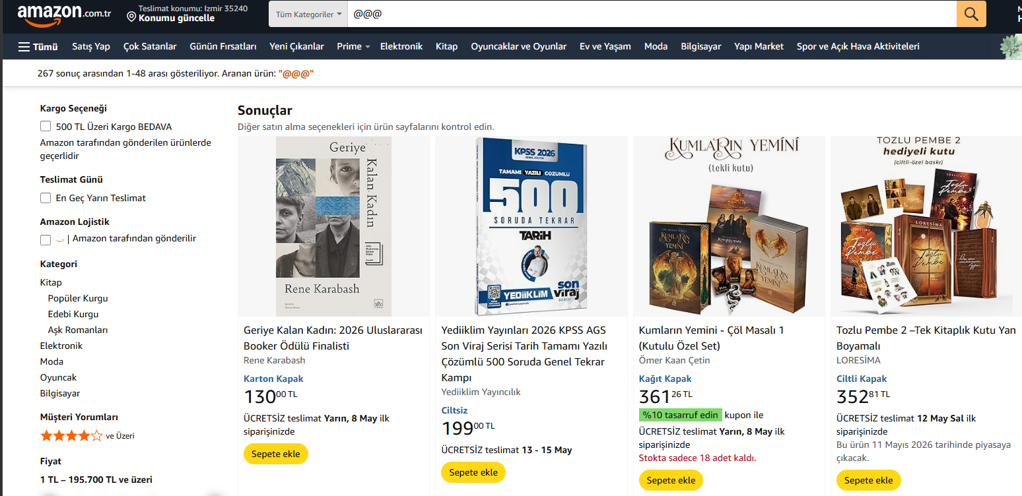
Search Bar: Special Character Error

Slide 6
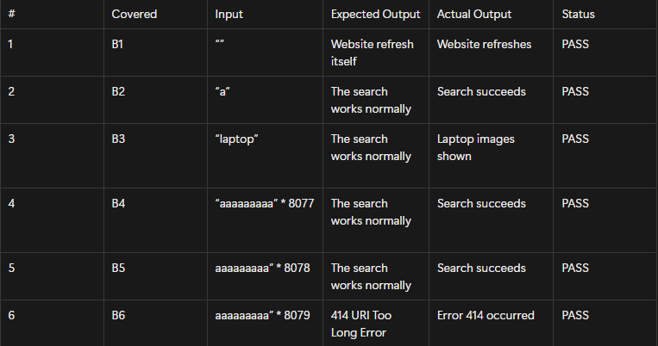
Search Engine: BVA
Tested By Using:
Min (e.g., 1 Character)
Max (e.g., 8078 Characters)
Min – 1
Max + 1
In Range
6 OUT OF 6 TESTS PASSED

Slide 7
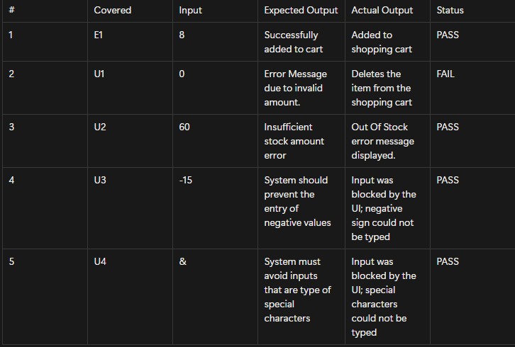
Shopping Cart: ECP
Description:
[1,30] Accepted Valid Stock
Tested By Using:
In Range
Zero
Far above max limit
Far above min limit
Special Characters
4 OUT OF 5 TESTS PASSED

Slide 8
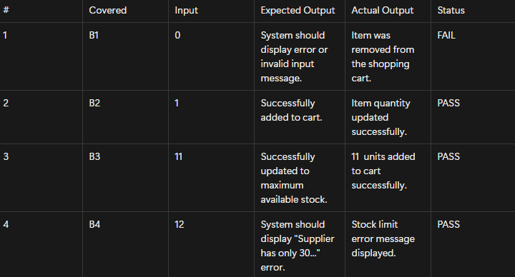
Shopping Cart: BVA
Description:
[1,11] Accepted Valid Stock
Tested By Using:
Min – 1
Min (e.g., 1)
Max (e.g., 11)
Max + 1
3 OUT OF 4 TESTS PASSED

Slide 9
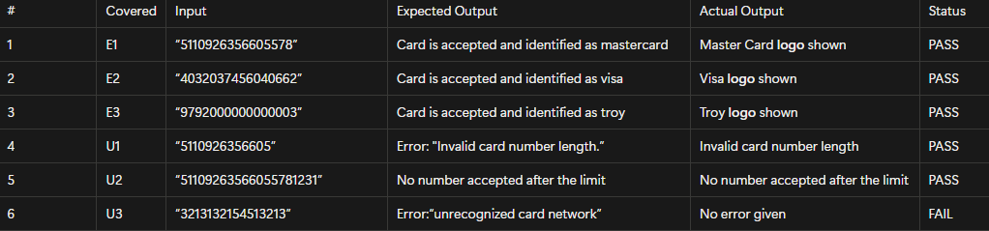
Card Number: ECP
Description:
1)Verify a valid card number and the correct card network identifier
Tested By Using:
Length of 16
Length of 13
Length of 20
5 OUT OF 6 TESTS PASSED

Slide 10
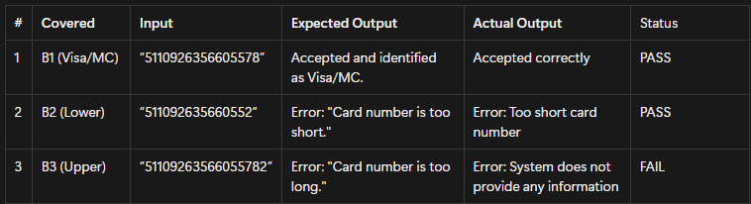
Card Number: BVA
Tested By Using:
Length of 16 CN
Length of 15 CN
Length of 17 CN
2 OUT OF 3 TESTS PASSED

Slide 11
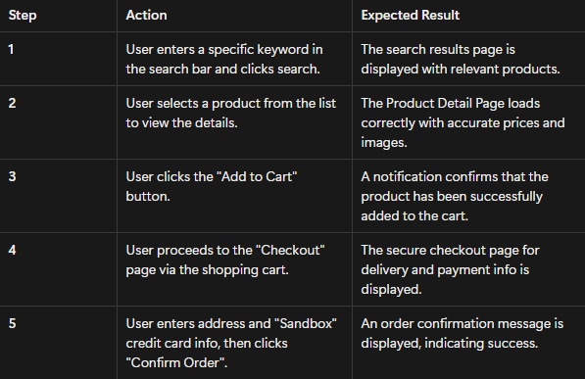
Use Case: Successful Purchase (Normal Flow)
User successfully buys an item by following:
Search -> Select -> Add to Cart -> Checkout -> Confirm Order

Slide 12
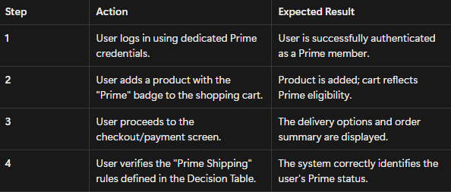
Use Case: Prime Advantages (Alternate Flow)
User successfully verifies the prime advantage by following:
Login -> Select -> Add to Cart -> Checkout -> Verify Advantage

Slide 13
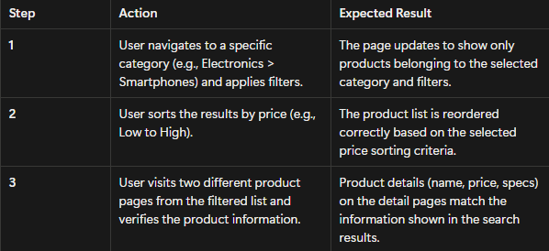
Use Case: Search & Compare (Alternate Flow 2)
User successfully compares the products by following:
Select Category -> Apply Filter -> Sort Price-> Browse different Product -> Verify Product Information

Slide 14
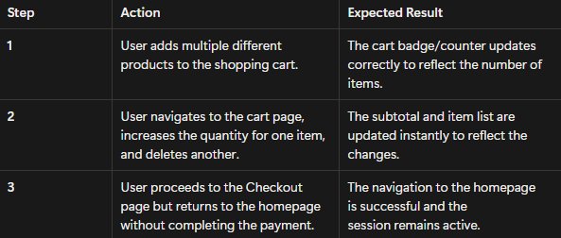
Use Case: Payment Cancellation (Exceptional Flow)
User cancels the payment process by following:
Add Products to Cart-> User alters quantity-> Sort Price-> User proceeds to checkout-> Cancel Payment

Slide 15
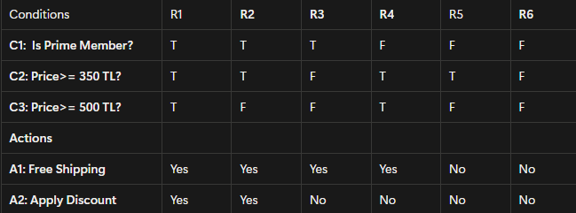
Decision Table: Free Shipping & Discount
Description: Reduced form because of contradictions on C2 & C3

Slide 16
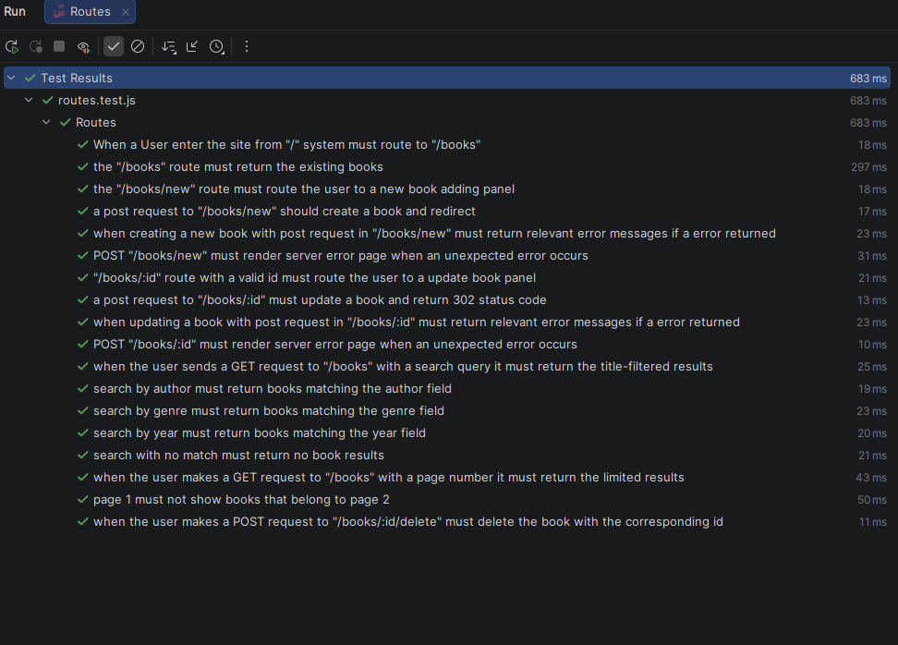
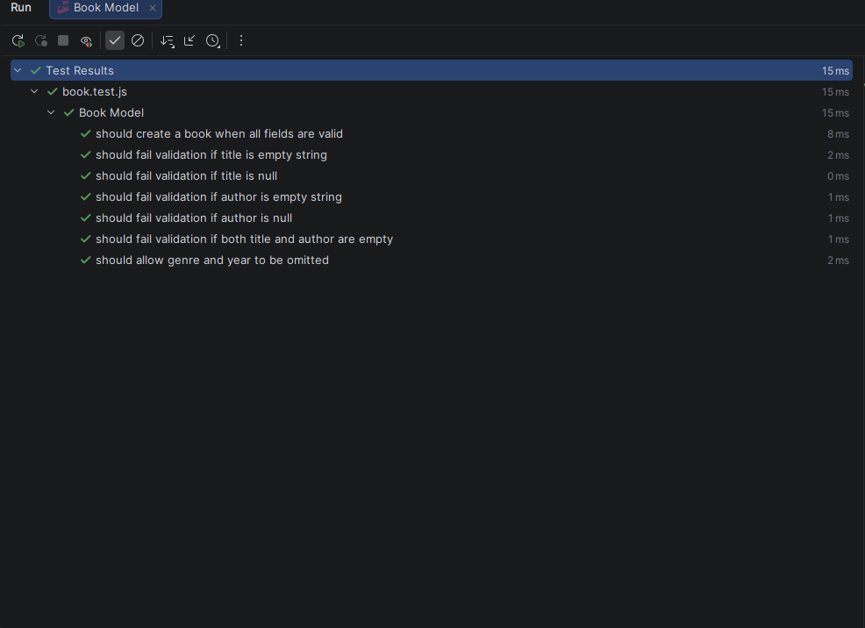
WhiteBox Techniques: Library DB Express
Unit Tests
Statement & Branch Coverage
Query Generator Validation
Database Integrity Checks

Slide 17
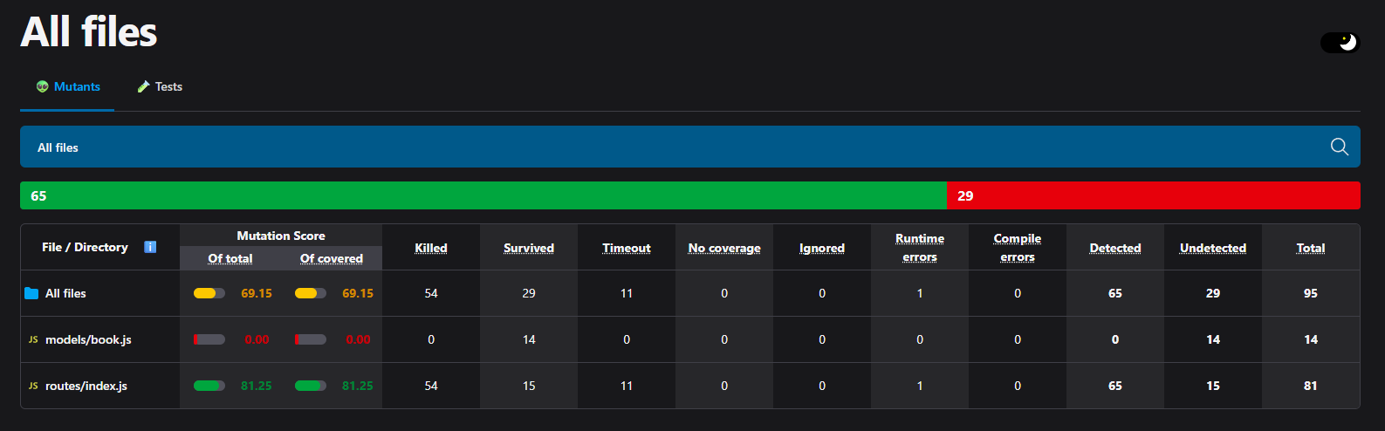
WhiteBox Techniques: Library DB Express
Mutation Testing

Slide 18
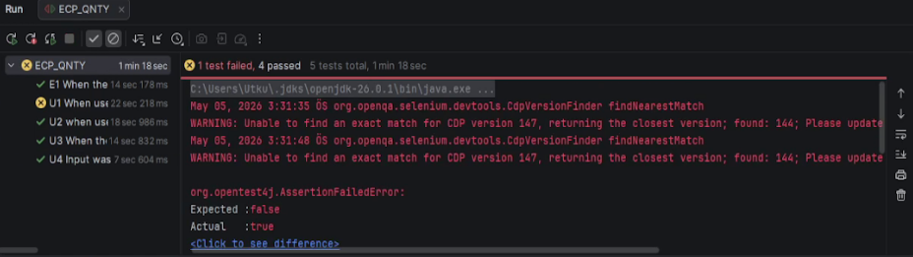
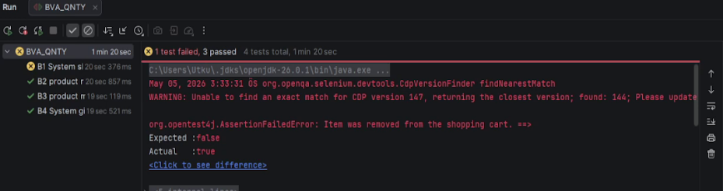
Web Automation: Selenium
Shopping Cart ECP
https://drive.google.com/file/d/1bnC7a7fKztlFTLxhqP3n9Zrq9mFArpPR
Shopping Cart BVA
https://drive.google.com/file/d/1hheJBT4zCxk3u8gQKQC_aQW5LGIQiNfz
Notes:
As we mentioned in the 7th and 8. slides

Slide 19
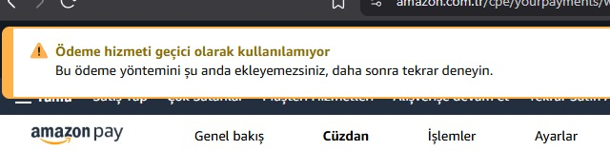
Web Automation: Selenium (Rate Limit Problem)
Notes:
One of the biggest issue we faced was rate limit in payment process bcs of the amazon’s bot protection thats why we tested manually

Slide 20
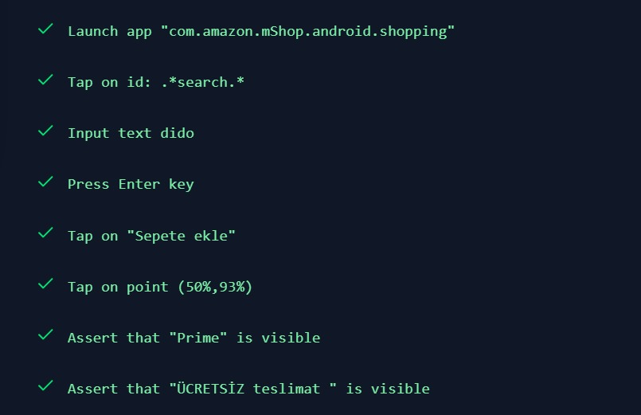
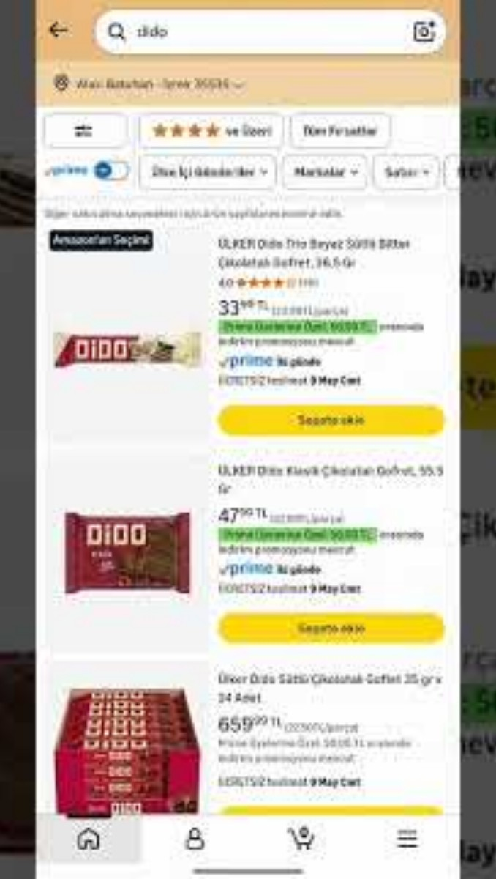
Mobile Automation: Maestro

Slide 21
Conclusion & References
THANK YOU FOR YOUR ATTENTION
SLIDE 1: https://www.theforage.com/blog/skills/quality-assurance
SLIDE 2: https://www.boardinfinity.com/blog/software-testing-what-it-is/
SLIDE 3: https://www.amazon.com.tr/
Batuhan Türk 24070006083 Utku Celal Turgut 24070006070 Aydın Alp Boyacı 24070006059

Slide 22
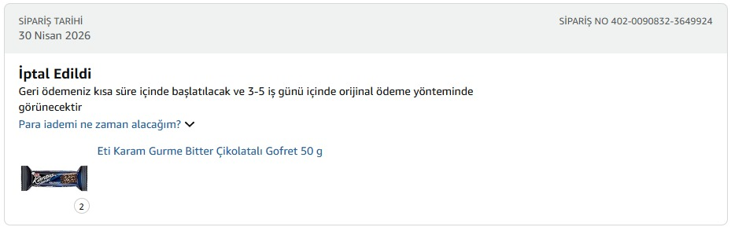
One of Our Off-Camera Incident

